Slide 1
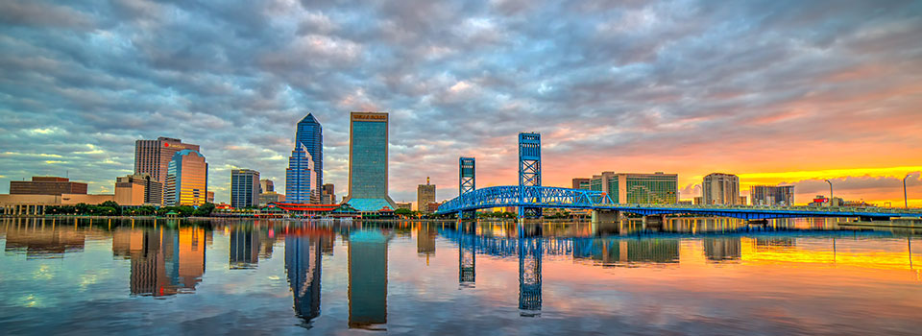
Green Infrastructure & Urban Greening in the City of Jacksonville
By: Evan Maslin

Slide 2
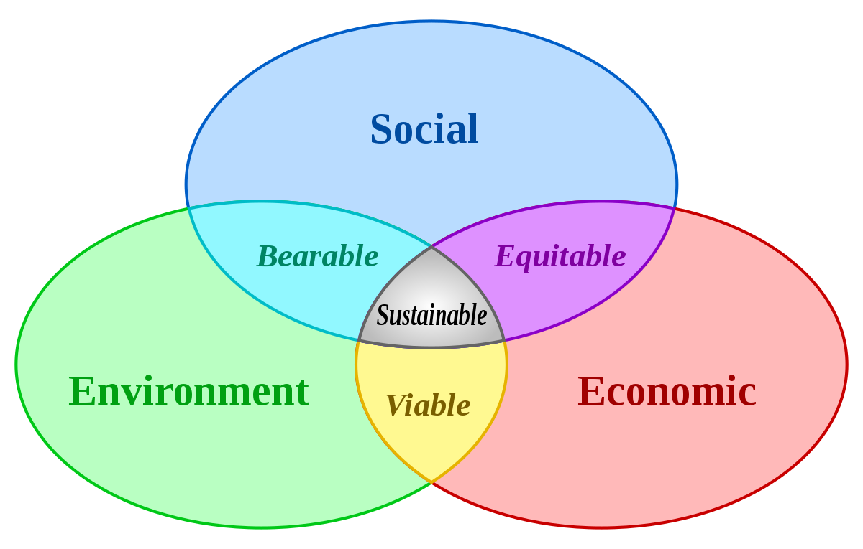
Sustainability Challenges
Biodiversity & habitat loss
Stormwater runoff
Sea-level rise & intracoastal flooding
Urban heating & greenhouse gas emissions
Water & air pollution

Slide 3
Establishing A Side Lot Program
Review & classification committee
Neighborhood/block-level planning strategies
Community land bank, trust, or public-private partnership
Amend City Ordinance Code
Transfer
Classification
Identification
Advertise
Redevelop
Acquisition

Slide 4
Benefits
Stormwater retention & flood mitigation
Biodiversity & habitat growth
Carbon storage/sequestration
Energy savings
Increase in home values
Reduction of crime (firearm violence)
Reduction of fatigue, stress, & heart rate
Increase in recreation & social cohesion

Slide 5
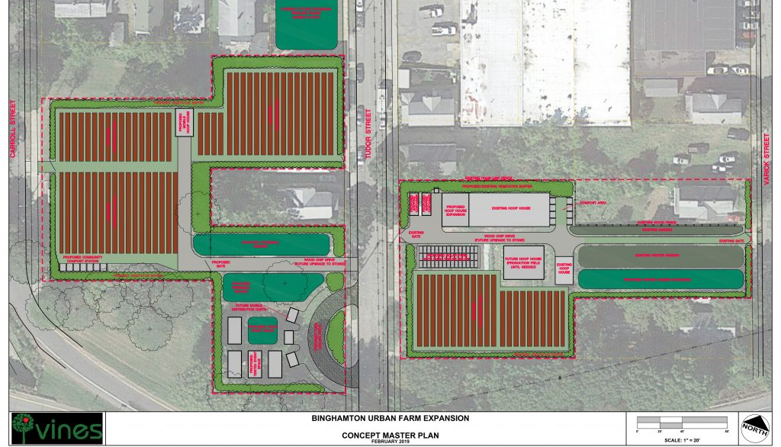
Side Lot Program in the City of Binghamton
100 properties have been purchased by the City and 20 have been resold
VINES Urban Agriculture Program
North Side Affordable Housing Project

Slide 6
Local Context in the City of Jacksonville
Differences in government structure, demographics, and severity of community blight
Similarities include urban core with historic areas, institutions of higher education, and environmental factors
Other unique considerations include geographic size of the City of Jacksonville

Slide 7
Conclusion
A side lot program is a pragmatic, economically feasible initiative that provides clear economic, environmental, and public health benefits
COJ should establish a pilot program that targets a specific neighborhood/area of the City, with measurable outcomes, and a publicly-informed community development plan
Green infrastructure can take many forms including land recovery, constructed wetlands, green streets, and urban farming
Any questions/comments should be directed to Evan Maslin (n01391092@unf.edu)

